Slide 1




Warehouse Management (WM)
Product
SAP ERP 6.0 EhP4
Global Bike Inc.
Level
Beginner
Focus
Cross-functional integration Warehouse Management

Slide 2
Functionality
Goods Receipt
Goods Issue
Picking
Packing
Shipping

Slide 3
Unit Overview
WM Organizational Structure
WM Master Data
WM Process Management and Control

Slide 4
WM Organizational Structure
Client
  An independent environment in the system
Company Code
  Smallest org unit for which you can maintain a legal set of books
Plant
  Operating area or branch within a company
    Manufacturing, distribution, purchasing or maintenance facility
Storage Location
  An organizational unit allowing differentiation between the various stocks of a material in a plant

Slide 5
WM Organizational Structure
Warehouse Number
  Number that identifies a complex, physical warehouse structure within the warehouse management system
Storage Type
  Subdivision of a complex, physical warehouse
  Is identified by its warehousing technique, form of organization, or its function
Storage Section
  Logical or physical subdivision of a storage type
  Groups together a series of similar storage bins
Picking Area
  Groups storage bins together from the standpoint of picking strategies

Slide 6
WM Organizational Structure
Storage Bin
  Smallest addressable unit in a warehouse, which identifies the exact location in the warehouse where goods can be stored
Warehouse door
  Marks the point where the means of transport changes to an internal transportation
Allocation Zone
  Temporary storage of goods, which have just arrived or will be shipped soon
Shipping Point
  Is the part of the company responsible for the type of shipping, the necessary shipping materials and the means of transport
Transportation Planning Point
  Place of planning and processing transportation activities

Slide 7
GBI 2.1 Structure for Warehouse Management
Global Bike
Client
Global Bike Inc. US
Global Bike Inc. DE
Company Code
Dallas
San Diego
Miami
Plant
Trading Goods
Finished Goods
Miscellaneous
Storage
Location
San Diego Warehouse
Warehouse
Number
Shelf Storage
GR Area Ext.
Receipts
Pallet Storage
Shipping area
Deliveries
Stock Transfers
(Plant)
Storage Type
Total Section
Storage Section
STBN-2-000
STBN-2-001
STBN-2-999
Storage Bin

Slide 8
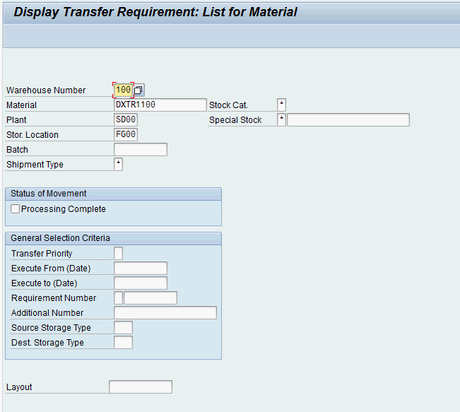
WM Master Data
Storage Bin Master Data
Material Master Data
Hazard Master Data
Batch Master Data

Slide 9
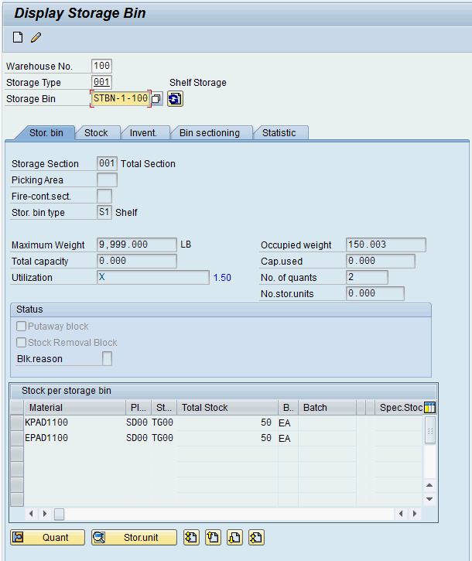
Storage Bin Master Data
Storage Bin Master Data
  Two different organizational levels
    Warehouse Level:
    All indicators and fields which are valid for the whole warehouse
    Storage Type Level:
    All indicators which are only valid for specific storage types
  Also includes Storage Bins and Quants

Slide 10
Storage Bin Master Data
Storage Bin
  Smallest addressable unit in a warehouse
  General Data
    Warehouse
    Storage type
    Storage bin number
  Storage Bin Data
    Storage section
    Picking area
    Fire-containment section
    Bin type
    Max. weight
  Status
    Blocked for putaway
    Stock removal block
    Blocking reason
General Data
Storage Bin Data (WM)
Status (MM)

Slide 11
Storage Bin Master Data
Quant
  Smallest addressable unit of measure for a material in SAP ERP
  General Data
    Material
    Plant / Storage location
    Batch
    Warehouse
    Storage type
    Storage bin
  Stock Data
    Total stock
    Available stock
  Block Indicator
    Block
    Putaway/removal status
General Data
Stock Data (MM)
Blocking Indicator (MM)

Slide 12
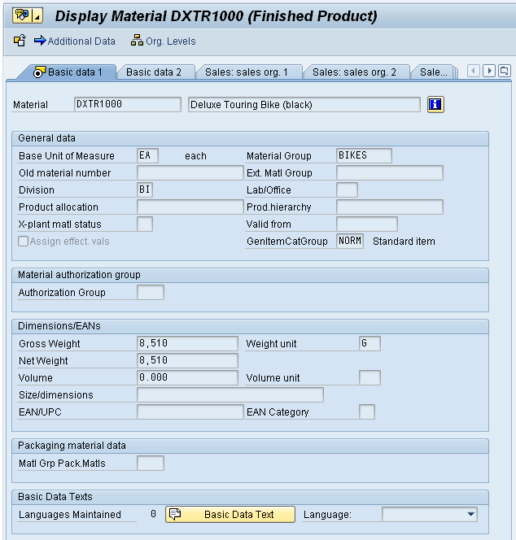
Material Master Data
Material Master
  Contains all the information a company needs to manage about a material
  It is used by most components within the SAP system
    Sales and Distribution
    Materials Management
    Production
    Plant Maintenance
    Accounting/Controlling
    Quality Management
  Material master data is stored in functional segments called Views

Slide 13
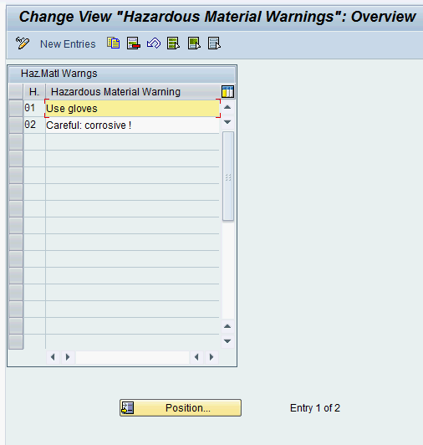
Hazard Master Data
Storage area for hazardous materials
  Flammable liquids
  Toxic materials
  Radioactive materials
General Data
  Storage class
  Water pollution class
  Flash point
  Aggregate state
  Hazardous material warning
  Hazardous substance number

Slide 14
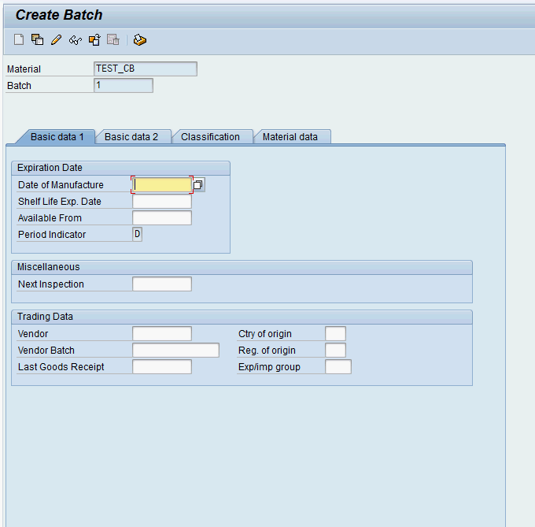
Batch Master Data
Subset of Material
  homogeneous series of unreproducible units with an unique specification
Basic Data 1 & 2
  Expiration date
  Inspection date
  Trading data
  Administration data
  Text data
Classification of Batch
Material data

Slide 15
WM Process Management and Control
Transfer requirement (TR)
  A request to transfer materials at a particular time from a source storage bin to a destination storage bin in a warehouse complex
  Represents the expected and scheduled goods movements in WM
  Generally generated by postings in the inventory management
  Consists of transfer request header and line items
Posting change notice (PCN)
  Generated by posting change processes in WM-administrated stocks
  Functionality similar to transfer requests
  Not necessarily combined with a physical goods movement
Transfer order (TO)
  Central documents for WM
  Every material movement requires a transfer order
  No difference between real and logical movement

Slide 16
Transfer Order
Creation of transfer order depends on preceding document
  Transfer request
  Posting change notice
  Outbound delivery
  Inbound delivery
Types of Transfer Order Creation
  Manual (TR, PCN, material document)
  Direct TO-Creation
  Automatic TO-Creation
  Manual (Delivery Monitor)

